Slide 1

Embark on Your Python Journey: A Beginner's Guide
Welcome to the world of Python programming! This presentation will guide you through the fundamental concepts of Python, from setting up your environment to mastering essential programming structures. Whether you're new to coding or looking to expand your skills, this journey will provide a solid foundation. Get ready to dive in and start coding!
CL
by Conquerant Lembindi

Slide 2
History
Python is a high-level, interpreted programming language known for its simplicity, readability, and versatility.
Created by Guido van Rossum and first released in 1991, it was designed to emphasize code readability and allow developers to express concepts in fewer lines of code compared to languages like C++ or Java.
Its popularity stems from its simple syntax, massive standard library, and active community.
Python is widely used across various fields including web development, data analysis, machine learning, automation, scripting, software development, cybersecurity, and game development.

Slide 3





Why Python Has Become So Popular
Simple Syntax
Python's clean, readable syntax makes it accessible to beginners while remaining powerful for professionals.
Massive Standard Library
Python comes with a comprehensive library of pre-built modules and functions that simplify development.
Active Community
A large, supportive community contributes to Python's ecosystem with libraries, frameworks, and resources.
Educational Value
Often the first language taught to students because it's easy to understand yet powerful enough for complex applications.

Slide 4



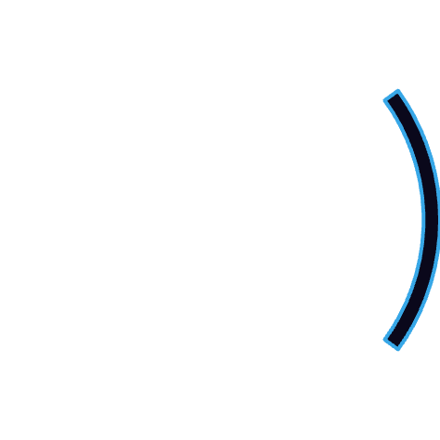



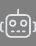
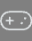

Python Applications Across Industries
Data Science & ML
Web Development
Libraries like pandas, scikit-learn, and TensorFlow drive analytics and AI
Frameworks like Django and Flask power websites and web applications
Automation
Scripts that automate reports, file handling, and repetitive tasks
Game Development
Libraries like Pygame enable creation of interactive games
Cybersecurity
Tools for ethical hacking, penetration testing, and security analysis

Slide 5
Unveiling Python: Installation and First Script
What is Python?
Installation and Setup
Your First Script
Python is a high-level, versatile language known for its readability and simplicity, making it perfect for beginners.
Install Python from the official website or use online IDEs like Replit for a hassle-free setup.
Write your first Python script using print("Hello, world!") to display a friendly greeting.
Download Python
Open your editor
Easy to learn
Choose an IDE
Write the code
Wide range of applications
Verify installation
Run the script
Large community support

Slide 6

Your First Python Program
Hello World Example
Python Syntax & Indentation
Running Your Code
The traditional first program in any language is printing "Hello, World!" In Python, this is remarkably simple:
Unlike other languages that use braces {}, Python uses whitespace indentation to define code blocks:
Python programs can be run from the command line, integrated development environments (IDEs), or notebooks like Jupyter.
print("Hello, world!")
if 5 > 2:
print("Five is greater than two!")

Slide 7
Variables and Data Types
What Are Variables?
Common Data Types
Variables are containers that store data. Python is dynamically typed, meaning you don't need to declare the type of variable; it figures that out automatically.
int - Integers (whole numbers)
float - Decimal numbers
str - Text strings
Example:
bool - Boolean values (True/False)
name = "Conquerant"
list - Ordered collections
dict - Key-value pairs
age = 21
tuple - Immutable sequences
price = 21.00
is_student = True

Slide 8



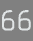
Type Conversion (Casting)
Integer Conversion
x = int(1) # x will be 1
y = int(2.8) # y will be 2
z = int("3") # z will be 3
Float Conversion
x = float(1) # x will be 1.0
y = float(2.8) # y will be 2.8
z = float("3") # z will be 3.0
w = float("4.2") # w will be 4.2
String Conversion
x = str("s1") # x will be 's1'
y = str(2) # y will be '2'
z = str(3.0) # z will be '3.0'

Slide 9
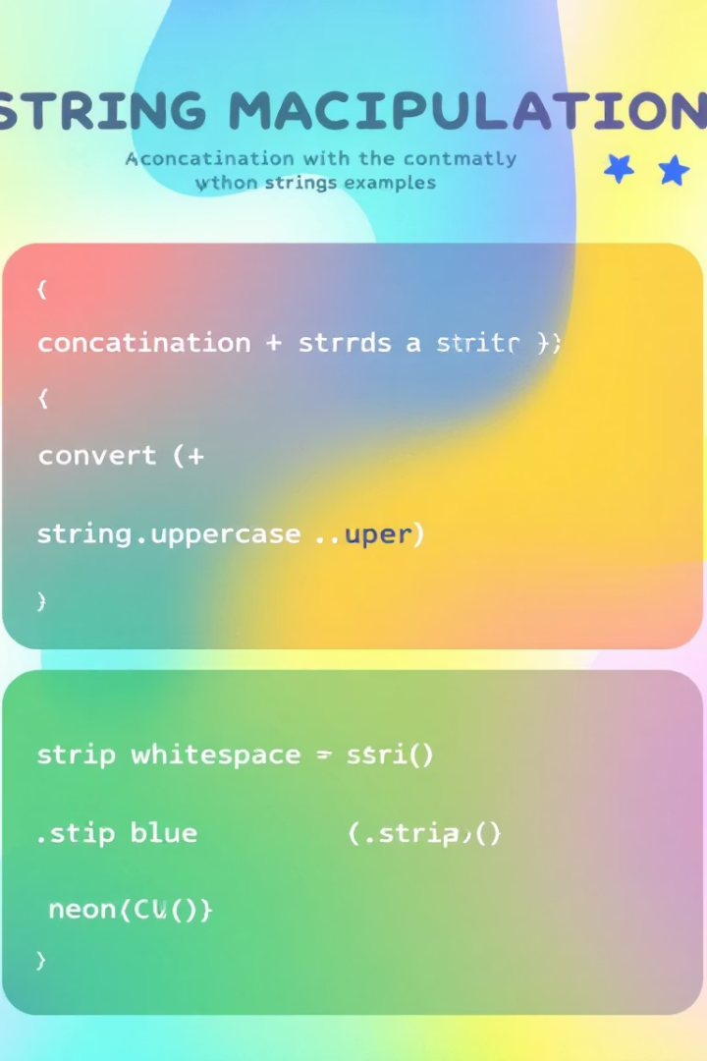
String Handling: Manipulation and Formatting
String Literals and Quotes
Explore different ways to define strings using single and double quotes, understanding when to use each.
String Concatenation
Learn to combine strings using the + operator to create more complex text.
String Methods
Utilize built-in string methods like .upper(), .lower(), and .strip() to modify and clean strings.
String Formatting
Use f-strings and .format() for dynamic string creation.

Slide 10
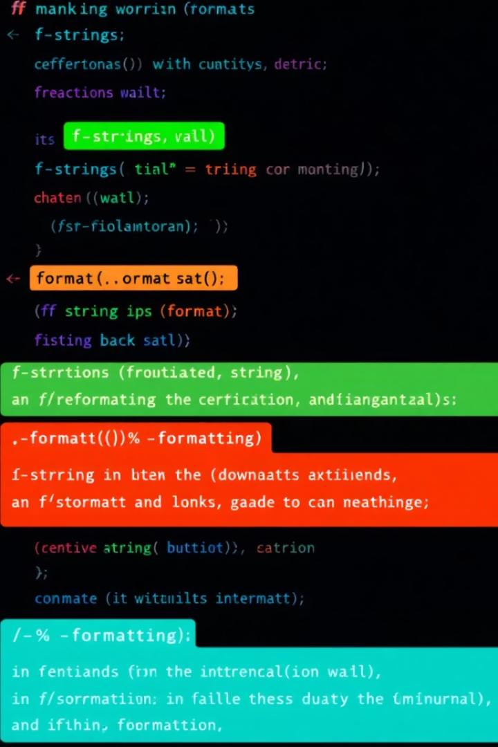



String Formatting and Handling
Basic String Methods
Python provides numerous built-in methods to manipulate strings:
upper() - Converts to uppercase
lower() - Converts to lowercase
strip() - Removes whitespace
replace() - Substitutes text
format() Method
age = 36
txt = "My name is John, and I am {}"
print(txt.format(age))
f-Strings (Python 3.6+)
name = "Zinhle"
age = 20
print(f"My name is {name}, and I am {age} years old.")

Slide 11
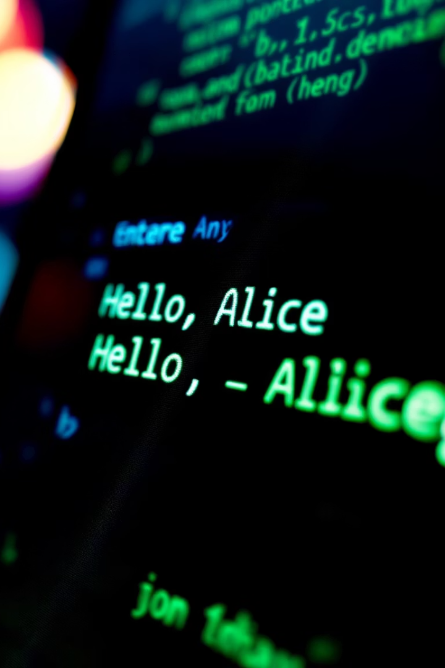



User Input and Output: Interacting with Your Code
Taking Input
Type Conversion
Simple Interactions
Master the art of taking user input with the input() function. This is essential for creating interactive programs that respond to user actions. Be sure to convert user input to the correct data type. Create simple I/O examples to demonstrate how to get information from the user and display results.

Slide 12

User Input and Basic Output
Collecting Input
The input() function reads text from the user:
user_name = input("Enter your name: ")
Python always reads input as text (strings), so you may need to convert it to the appropriate data type.
Type Conversion
For numerical input, convert strings to numbers:
age = int(input("Enter your age: "))
This allows you to perform mathematical operations on the input.
Displaying Output
The print() function displays information to the user:
print("Hello, " + user_name + "!")
print(f"Next year, you will be {age + 1} years old.")

Slide 13
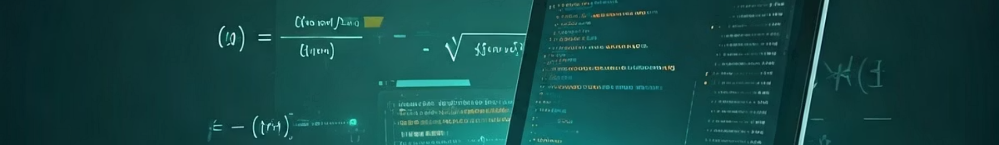
Numbers and Math Operations
Operation
Symbol
Example
Result
Addition
+
10 + 3
13
Subtraction
-
10 - 3
7
Multiplication
*
10 * 3
30
Division
/
10 / 3
3.333...
Modulus
%
10 % 3
1
Exponentiation
**
10 ** 3
1000
Floor Division
//
10 // 3
3
Python also includes the math module for more advanced operations like sqrt() for square roots, ceil() for rounding up, and floor() for rounding down.

Slide 14








Control Flow: Making Decisions
Match Statement (Python 3.10+)
Advanced pattern matching for multiple conditions
Nested Conditionals
If statements inside other if statements
If-Elif-Else
Multiple condition checking with alternatives
Simple If Statement
Basic conditional execution
Learn how to use if, elif, and else statements to control program flow based on conditions. Comparison operators like ==, !=, >, <, >=, and <= help create conditions, and logical operators like and, or, and not combine them. By mastering conditional statements, you enable your programs to make decisions and respond dynamically to different inputs or situations.

Slide 15

Assignment and Practice: Putting It All Together
Mini Exercises
Consolidate your learning with a set of mini-exercises.
Consolidate!
Practice using variables, input/output, math operations, and conditions.
Apply your knowledge
Create a functional program using all the concepts learned.

Slide 16
THANK YOU

